Slide 1

TaskQuest
React Task management System

Slide 2
Our team:
Team Leader : Zyad walid
Team members :
Sayed AbdElaal
Omar Wagih
Omar Zidan
Hassan Magdy

Slide 3

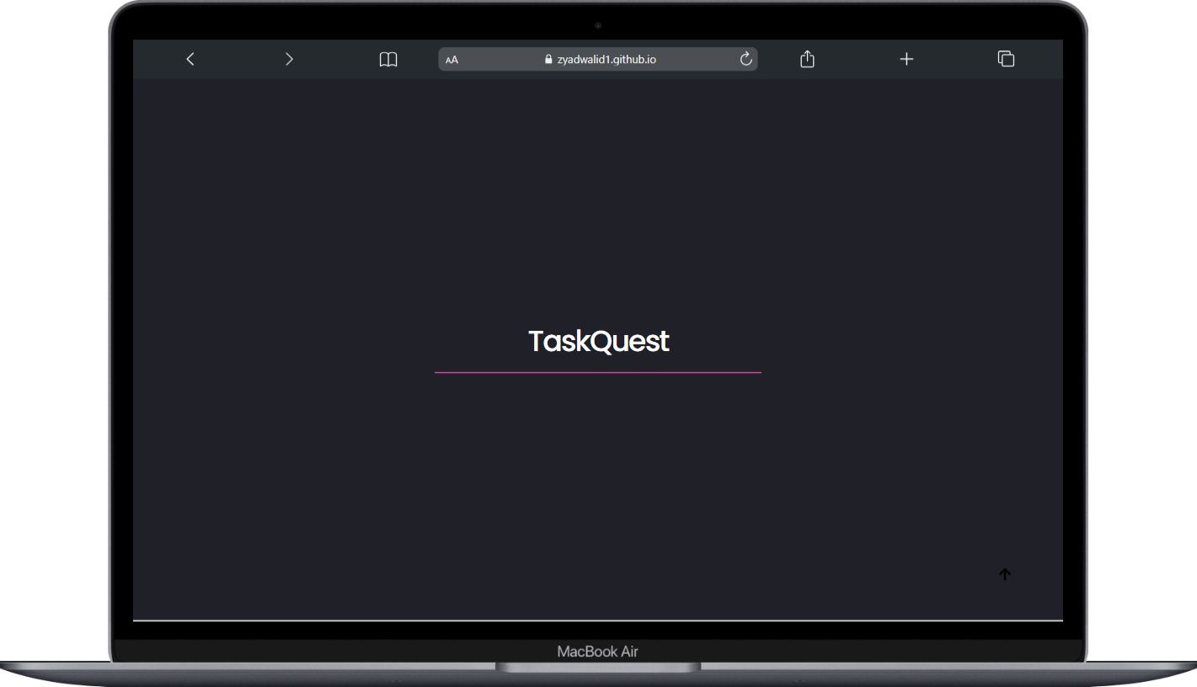
App Overview :
TaskQuest is a task management system designed to streamline the process of managing and tracking tasks efficiently. With a user-friendly interface, the app offers key features that make task creation, organization, and monitoring effortless. From setting priorities and due dates to viewing progress and analyzing completion times, TaskQuest ensures users stay productive while customizing their experience through various themes and language options.

Slide 4
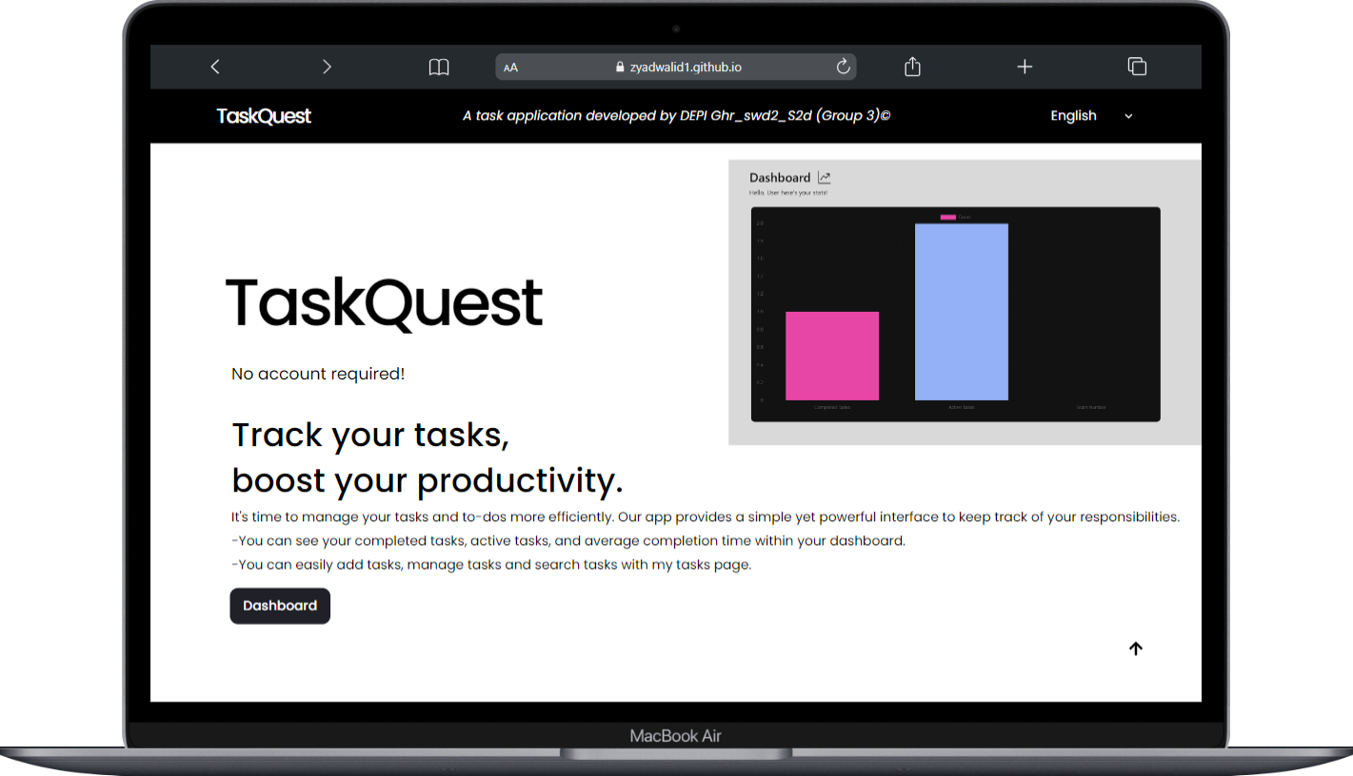
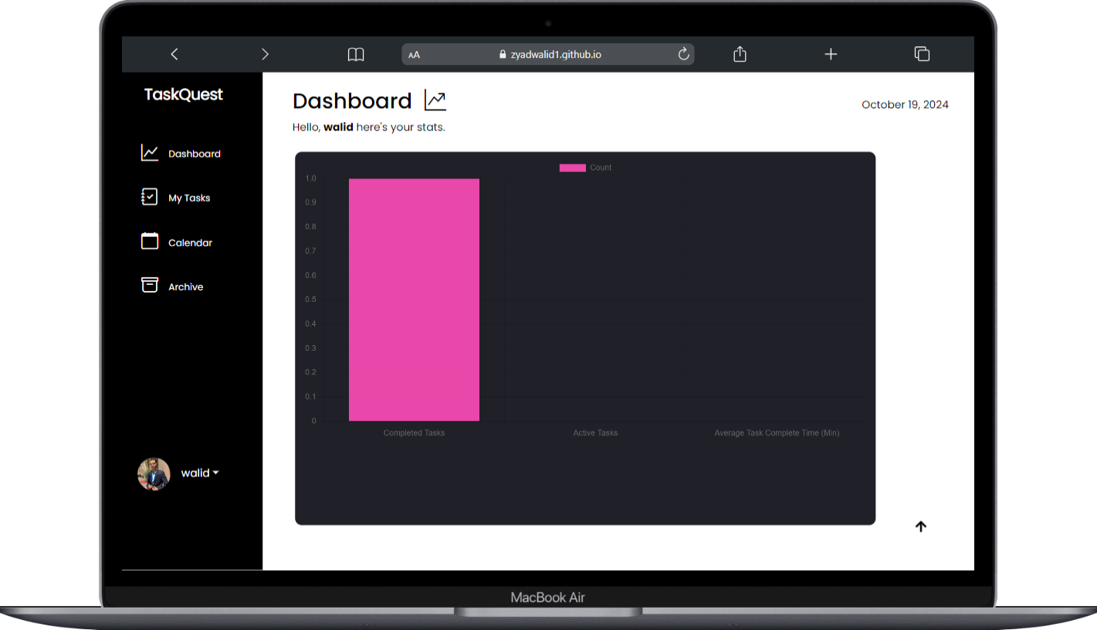
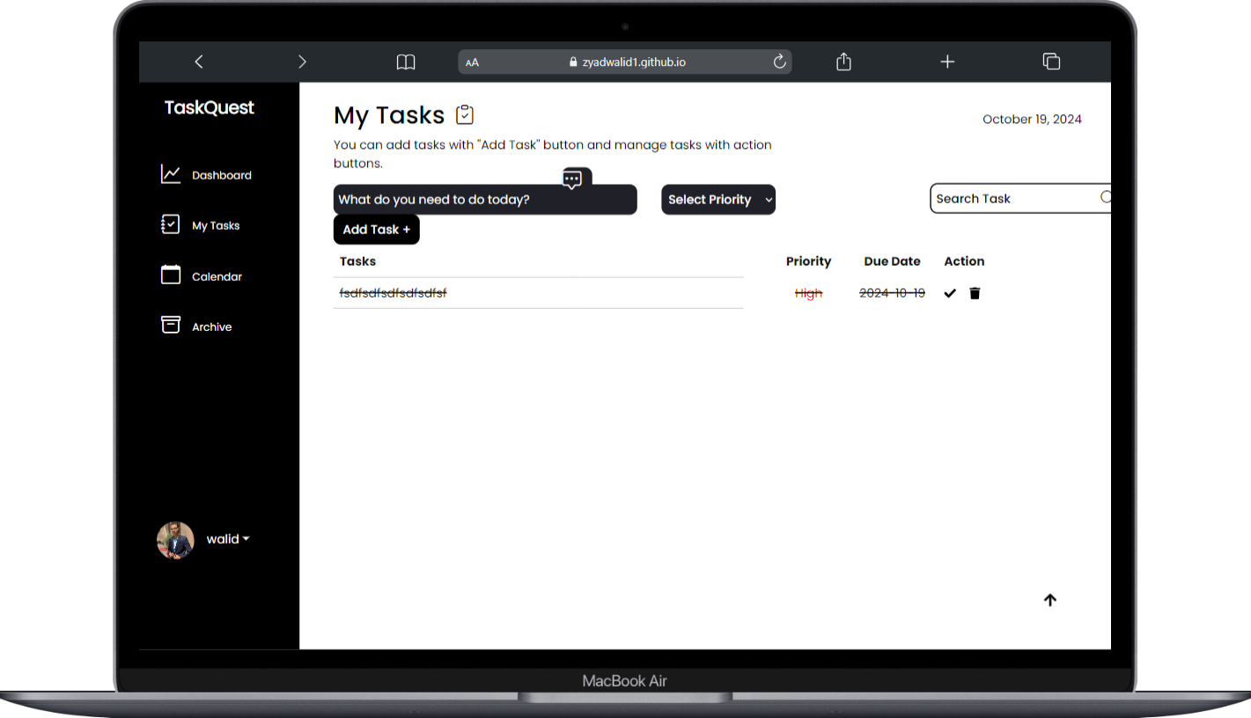
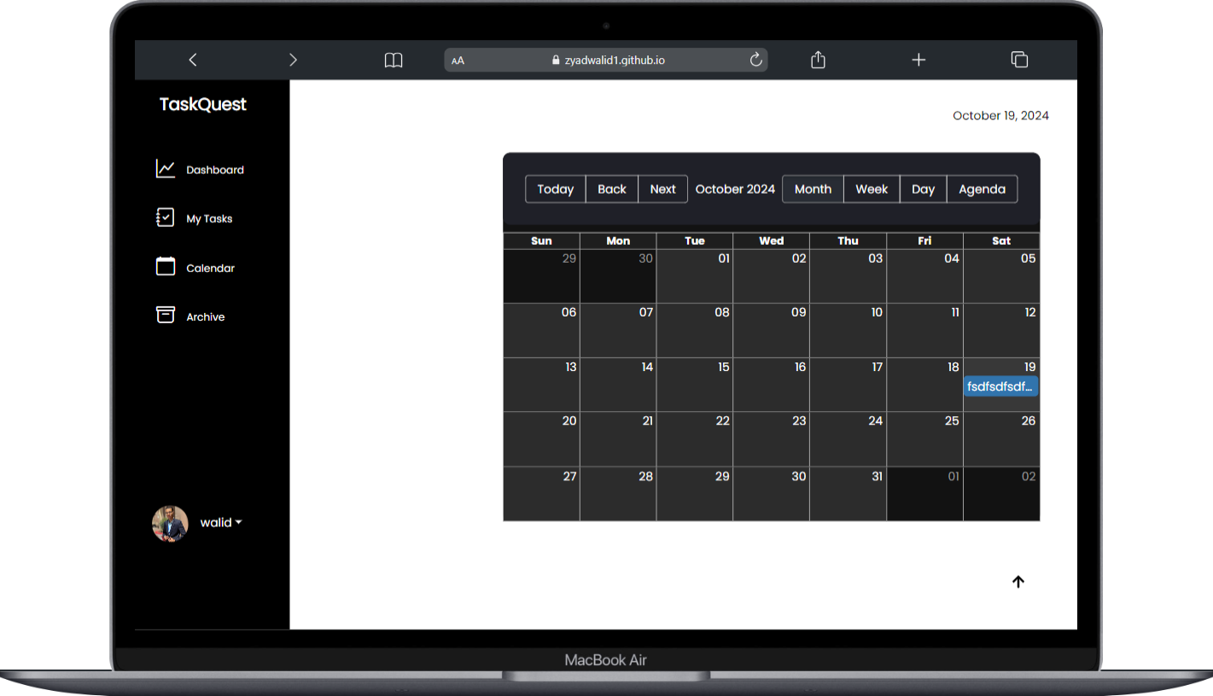
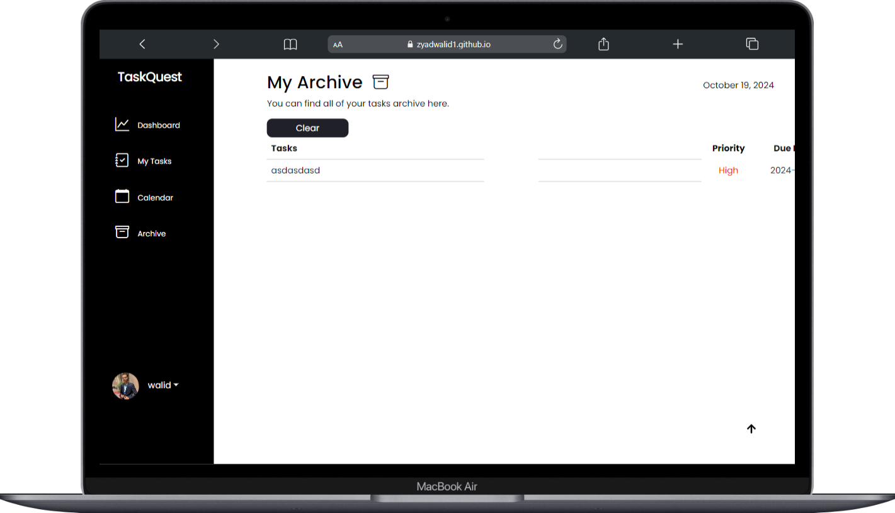
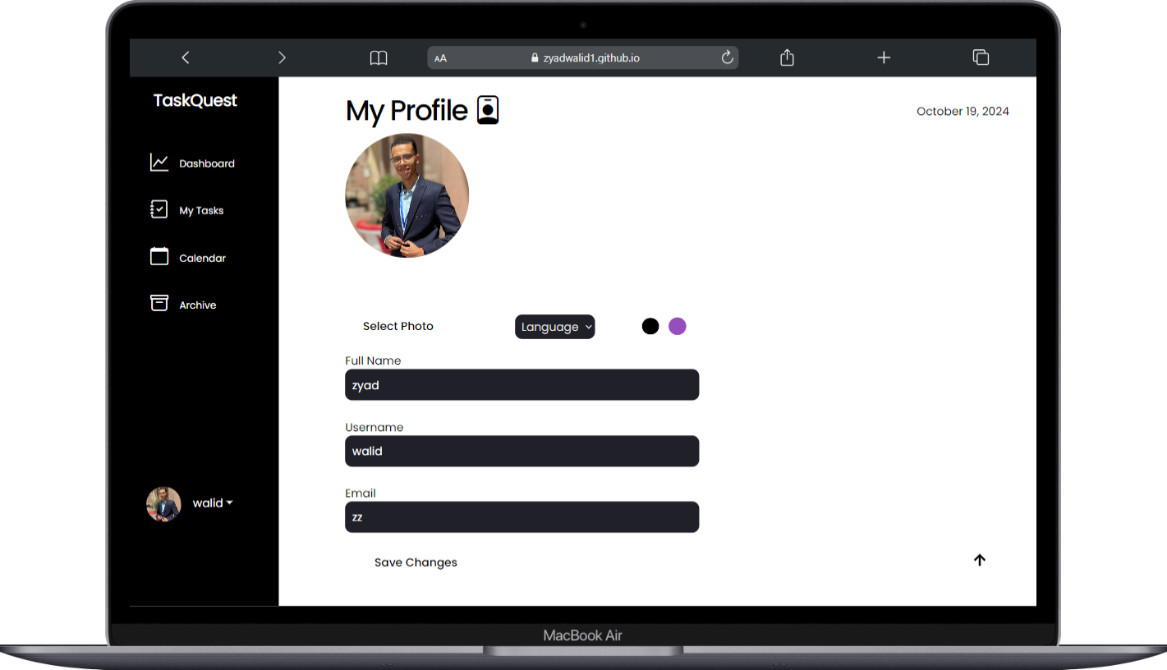
Screens
Home page :
Dashboard :
My Tasks :
Calander :
Archive :
Profile :

Slide 5
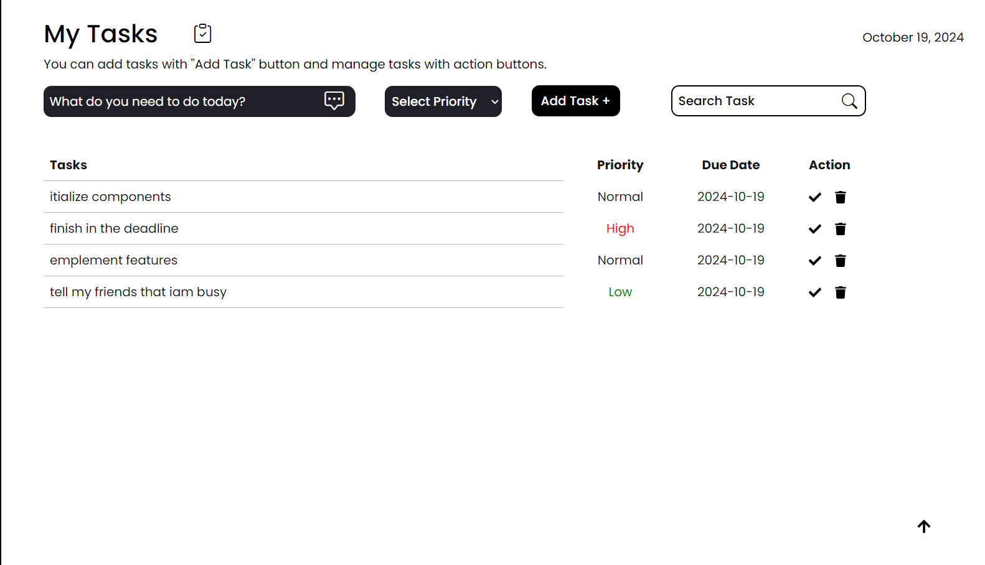
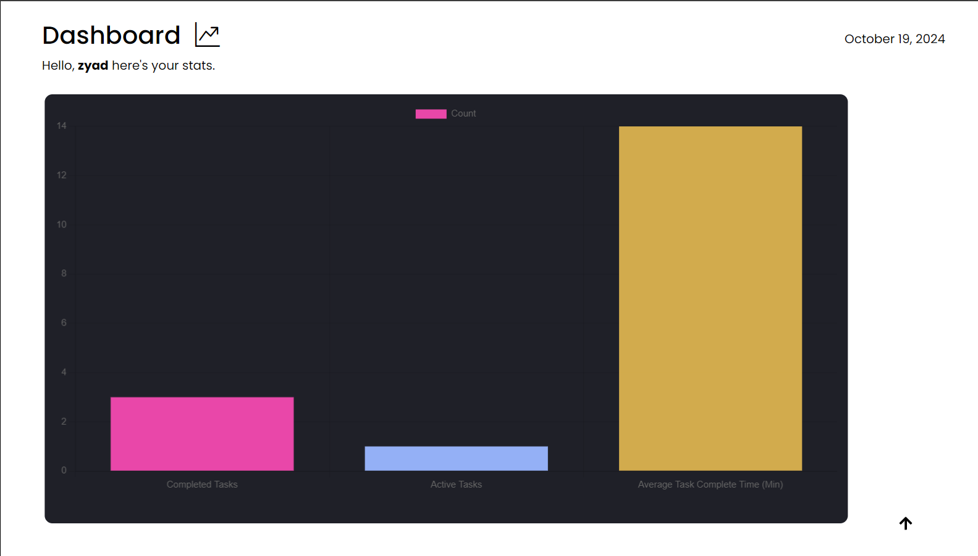
Features :
• Create, delete, and search tasks effortlessly
• Set task priorities: High, Normal, or Low to maintain focus
• Assign due dates to ensure timely task completion
• Visualize task progress with in-progress and completed task numbers via Chart.js
• Monitor average task completion time in minutes

Slide 6
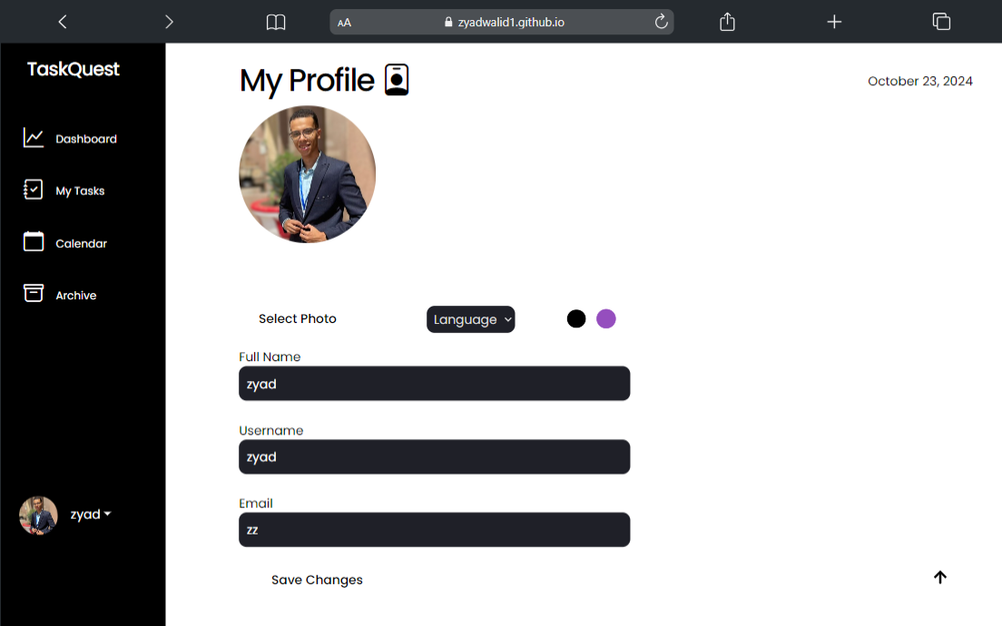
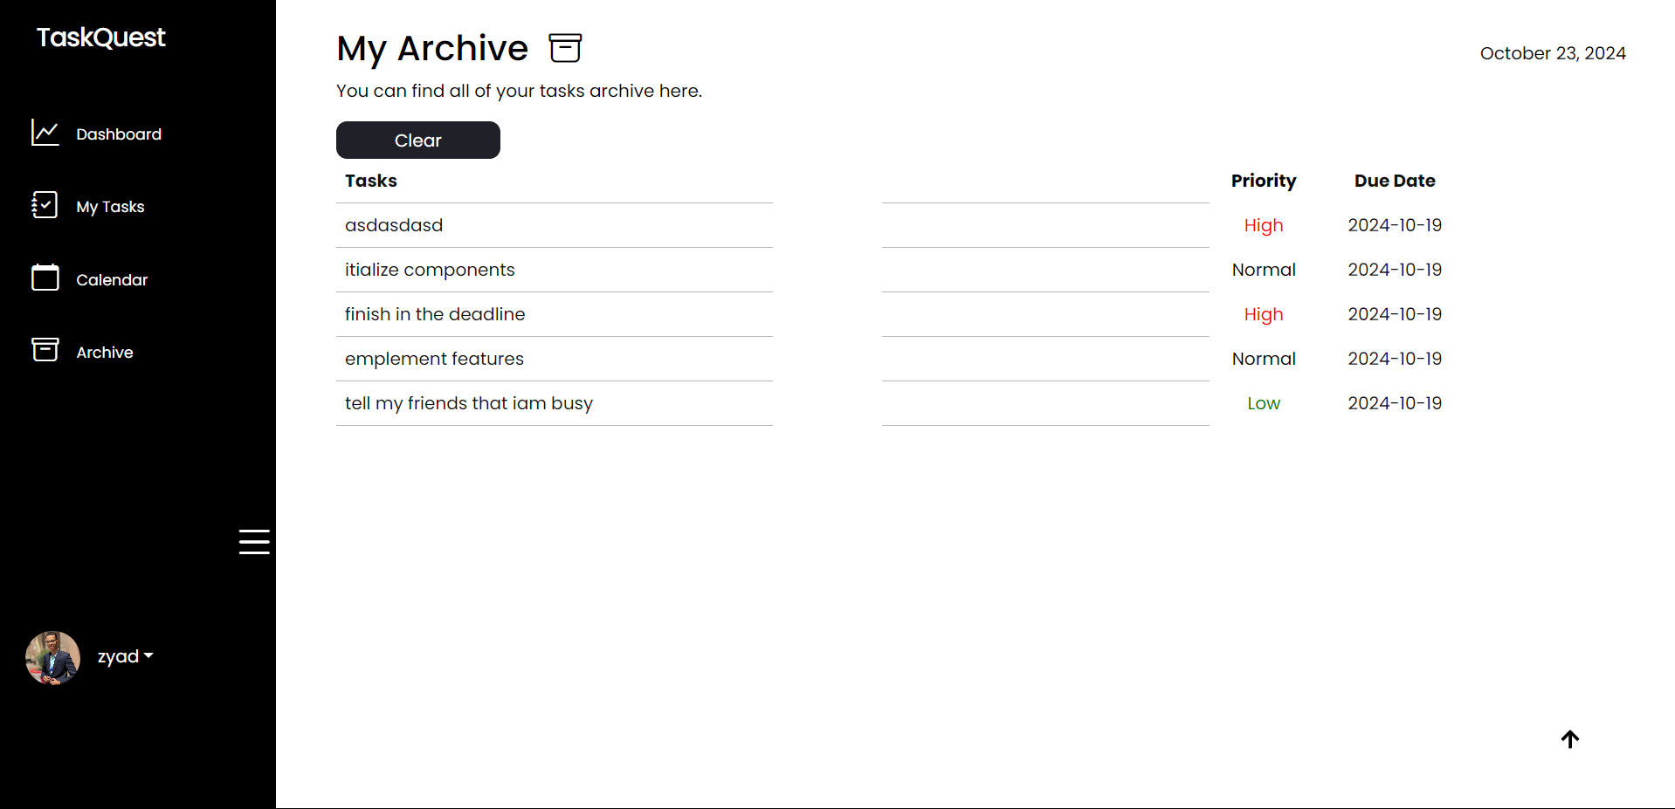
• Personalize your profile with photo, name, username, and email details
• Archive tasks automatically upon completion for record-keeping

Slide 7
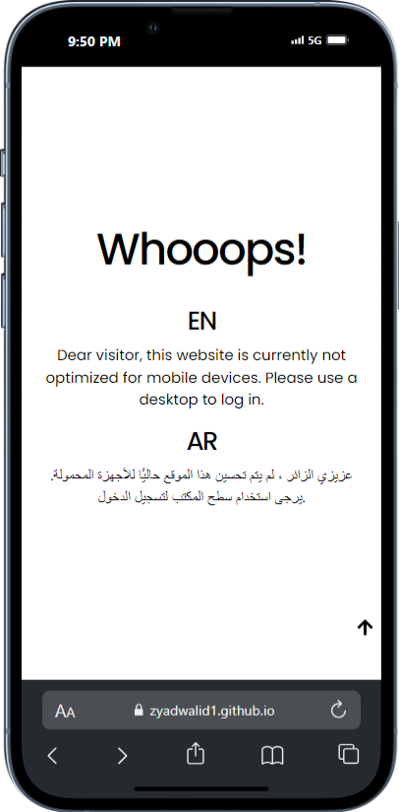
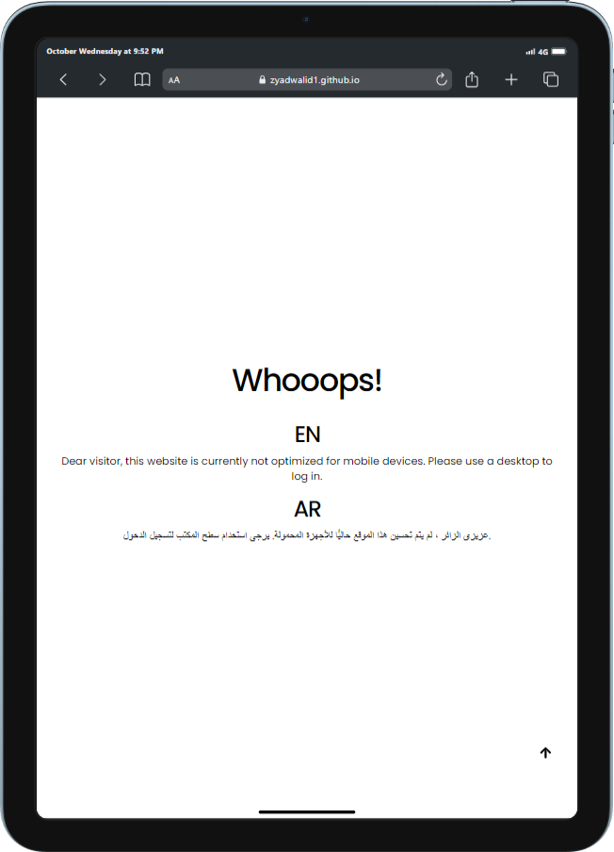
• Detect the device in use to tailor the user experience accordingly

Slide 8
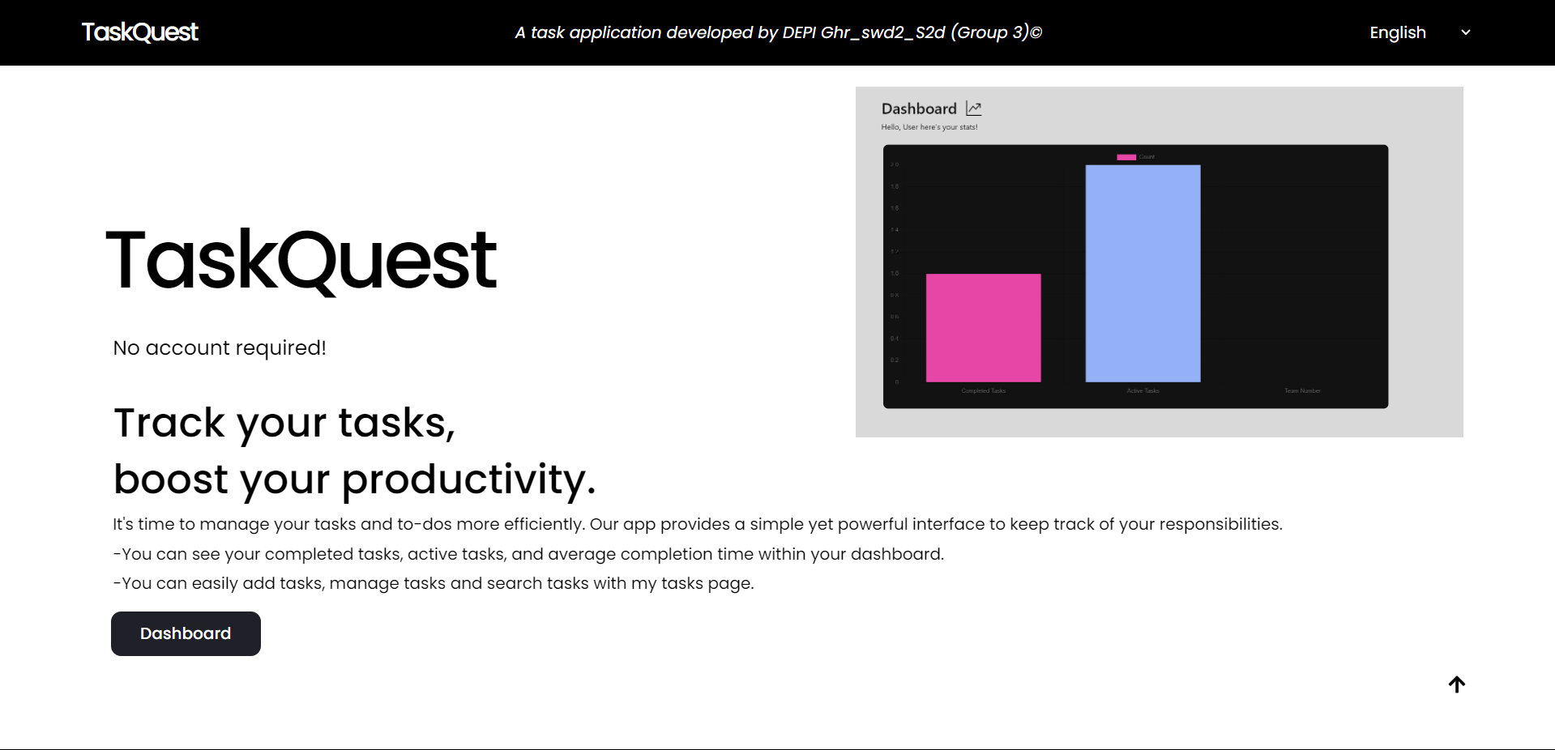
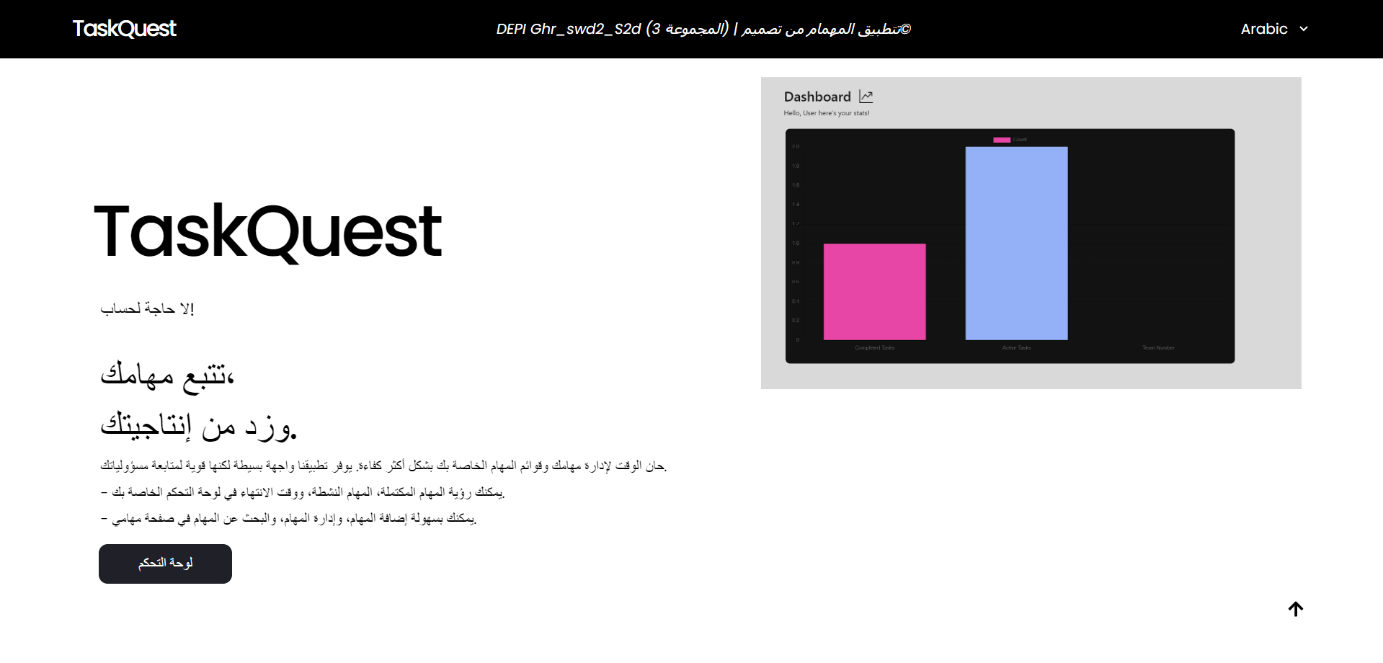
• Seamlessly toggle between Arabic (AR) and English (EN) language support using React-i18Next

Slide 9
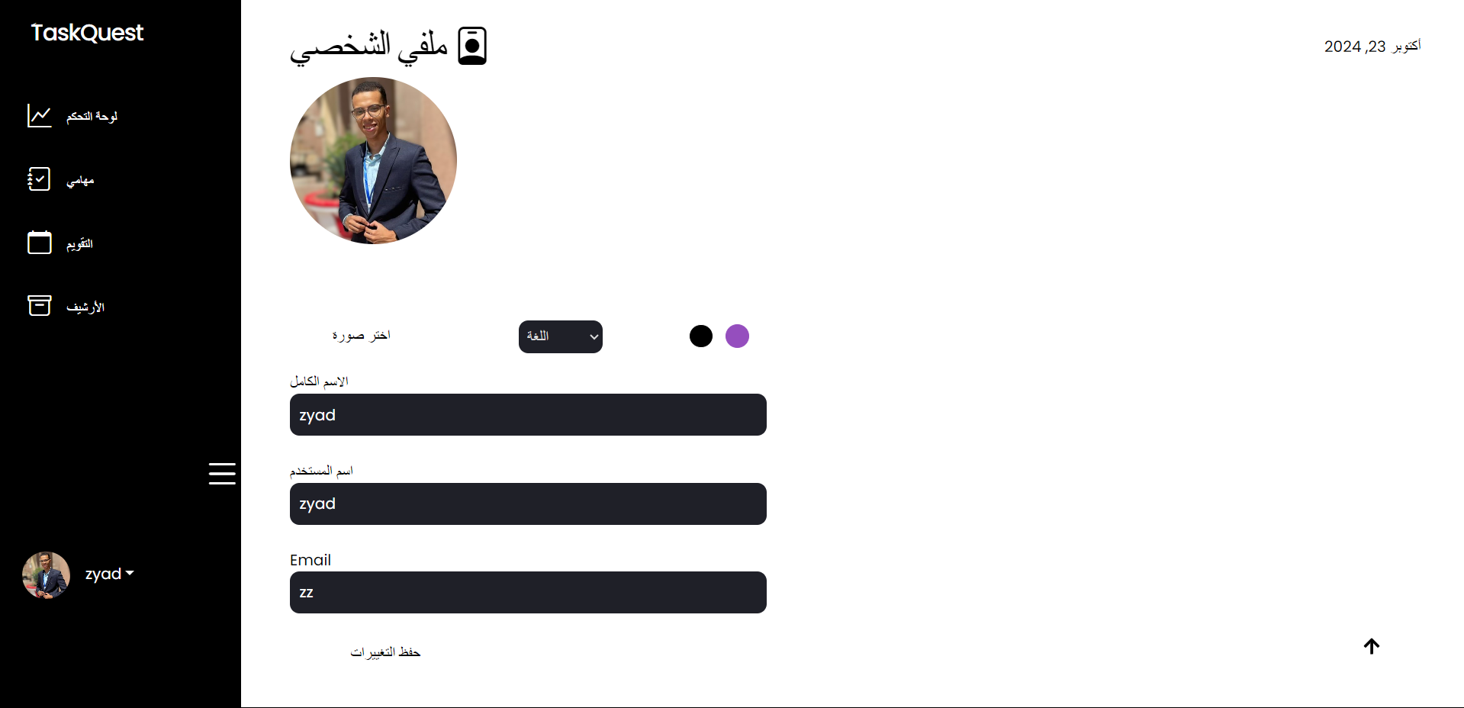
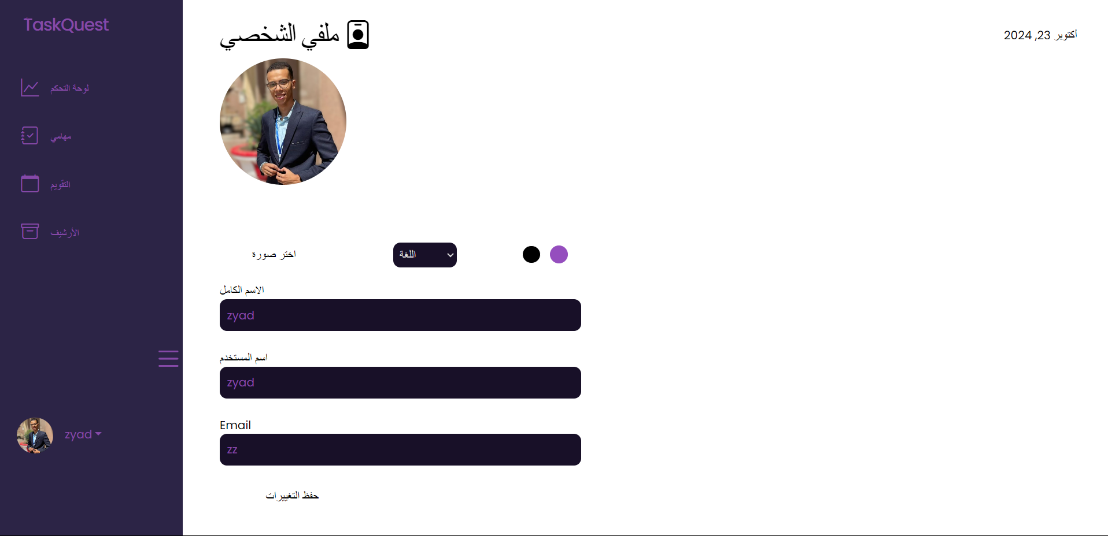
• Switch between Light and Purple themes for a customized look

Slide 10
Technologies & Libraries Used
TaskQuest leverages a variety of modern technologies to ensure a smooth, efficient, and responsive user experience. The app is powered by the following tools and libraries:
• React.js for building an interactive and dynamic frontend
• i18n for internationalization, providing multilingual support
• Chart.js for visualizing task progress and completion statistics
• LocalStorage and IndexedDB for storing user preferences and data locally

Slide 11
Thank you !
Any Questions ?

